Slide 1
HPC User Group
Lilac and Juno Clusters
November 6 2019

Slide 2
Agenda
  General HPC infrastructure updates.
  Lilac and Juno cluster utilization.
  New LSF GPU features.
  Storage options.
  /scratch & /fscratch cleanup policy.
  Luna cluster retirement.
  Jupyter Notebook.
  Q&A

Slide 3
Lilac computational resources
November, 2019 1/2
name | # | model | CPU | GPU | cores | RAM | Access
ld06-07 | 2 | Nvidia DGX-1 | 2Xeon(R) 2.20GHz | 8xTeslaV100-SXM2-16GB | 40 | 512 | All users
ls01-18 | 18 | Super micro | 2Xeon(R) 2.30GHz | 4xGeForce GTX 1080 | 36 | 512 | All users
lt01-08 | 8 | Super micro | 2Xeon(R) 2.30GHz | 4xGeForce GTX 1080Ti | 36 | 512 | All users
lt09-22 | 14 | Super micro | 2Xeon(R) 2.30GHz | 4xGeForce GTX 1080Ti | 36 | 512 | All users
lv01 | 1 | Super micro | 2Xeon(R) 2.30GHz | 4xTeslaV100 PCIE-16GB | 36 | 512 | All users
lu01-12 | 12 | Super micro | 2Xeon(R) 2.30GHz | 4xGeForce RTX 2080 | 36 | 512 | All users

Slide 4
Lilac computational resources
November, 2019 2/2
name | # | model | CPU | GPU | cores | RAM | Access
lg01,02,06 | 3 | Exxact | 2Xeon(R) 2.30GHz | 4xTITANX | 36 | 512 | ACL
lg03,04 | 2 | Exxact | 2Xeon(R) 2.30GHz | 4xPascal | 36 | 512 | ACL
lp01-35 | 35 | Supermicro | 2Xeon(R) 2.30GHz | 4xGeForce GTX 1080Ti | 24 | 512 | ACL
ld01-05 | 5 | Nvidia DGX-1 | 2Xeon(R) 2.20GHz | 8xTeslaV100 SXM2-16GB | 40 | 512 | ACL
Total | 100 |  |  | 404 | 3,208
ACLs control access to nodes purchased by partner PIs and departments. All users can run short jobs (walltime < 6 hours) on these nodes when slots are available.

Slide 5
Lilac cluster utilization 01/01-01/10 2019
 | Wall Time Hours | Jobs
cpuqueue | 9,293,147 | 5,740,809
gpuqueue | 3,159,459 | 279,142
Total | 12,640,795 | 6,020,201

Slide 6
Lilac cpuqueue top 10 users
01/01-10/01 2019
User Name | Wall Time Hours | Total Jobs | Total Slots | Done Slots | Exited Slots
schaumba | 2,198,496.00 | 54,170 | 1,268,458 | 869,269 | 399,189
chodera | 1,317,212.00 | 52,692 | 427,575 | 195,774 | 231,801
makarovv | 744,877.91 | 194,103 | 312,159 | 275,921 | 36,238
selenicp | 487,046.58 | 1,084,579 | 1,846,935 | 1,816,070 | 30,865
krc3004 | 429,391.82 | 30,985 | 117,471 | 88,955 | 28,516
peix | 410,705.71 | 42,774 | 129,929 | 59,171 | 70,758
brownd7 | 367,091.20 | 1,238,684 | 2,030,233 | 1,952,757 | 77,476
chayas | 260,449.18 | 182,487 | 667,214 | 605,723 | 61,491
ratnakua | 192,731.29 | 48,268 | 125,380 | 45,305 | 80,075
hiter | 187,779.68 | 14,786 | 1,088,574 | 1,075,674 | 12,900

Slide 8
Lilac gpuqueue top 10 users
01/01-10/01 2019
User Name | Wall Time Hours | Total Jobs | Total Slots | Done Slots | Exited Slots
gabriele | 795,265.88 | 3,917 | 53,089 | 28,434 | 24,655
wangy1 | 617,724.29 | 1,589 | 38,992 | 796 | 38,196
pavletin | 373,059.52 | 1,418 | 103,716 | 50,326 | 53,390
schaumba | 232,094.27 | 1,091 | 23,498 | 7,201 | 16,297
hassan | 145,494.10 | 505 | 10,294 | 2,772 | 7,522
xiec | 114,575.52 | 2,634 | 12,684 | 3,249 | 9,435
hod | 114,465.98 | 363 | 7,506 | 4,191 | 3,315
hiter | 75,152.35 | 7,466 | 68,587 | 65,416 | 3,171
jiangj1 | 63,126.52 | 667 | 675 | 60 | 615
williat4 | 61,338.92 | 664 | 16,564 | 20 | 16,544

Slide 10
Juno computational resources as of November, 2019
name | # | model | CPU | cores | RAM | NVMe
ju01-15 | 15 | HPE DL160G9 | 2Xeon®2.60GHz | 16 | 256
jv01-04 | 4 | HPE DL160G9 | 2Xeon®2.60GHz | 16 | 256
jx01-34 | 34 | Supermicro | 2Xeon®2.40GHz | 20 | 256 | 2x2TB
jy01-03 | 3 | Supermicro | 2Xeon®2.40GHz | 36 | 512
ja01-10 | 10 | Supermicro | 2Xeon®2.30GHz | 36 | 512 | 2TB
jb01-24 | 24 | Supermicro | 2Xeon®2.30GHz | 36 | 512 | 2TB
jc01-02 | 2 | Supermicro GPU 4 2080 | 2Xeon®2.30GHz | 36 | 512 | 2TB
jd01-04 | 4 | Supermicro | 2Xeon®2.30GHz | 36 | 512 | 2TB
Total | 97 |  |  | 2,548

Slide 11
Juno cluster utilization 01/01-01/10 2019
Queue | Wall Time Hours | Jobs
general | 10,377,920 | 24,389,171
control | 233,331 | 30,225
Total | 10,615,281 | 24,441,540

Slide 12
Juno general queue top 10 users
01/01-10/01 2019
User name | Wall Time Hours | Total Jobs | Total Slots | Done Slots | Exited Slots
isablbot | 3,117,711.00 | 9,123,062 | 9,689,714 | 9,622,427 | 67,287
leukbot | 773,365.00 | 4,180,435 | 4,202,648 | 4,109,723 | 92,925
biederse | 858,957.00 | 784,350 | 4,006,491 | 3,263,791 | 742,700
gongy | 967,571.00 | 873,981 | 3,403,861 | 2,954,551 | 449,310
jonssonp | 687,925.72 | 1,286,923 | 2,554,840 | 2,172,952 | 381,888
socci | 469,526.00 | 609,250 | 2,191,355 | 1,809,856 | 381,499
zeng | 412,060.98 | 538,891 | 1,949,807 | 1,947,196 | 2,611
grewald | 256,507.17 | 1,547,810 | 1,759,217 | 1,749,595 | 9,622
mpirun | 67,102.39 | 231,787 | 1,104,402 | 1,088,831 | 15,571
medinaj | 203,039.14 | 822,423 | 828,705 | 801,139 | 27,566

Slide 14
New LSF GPU features
LSF Version 10.1 Fix Pack 8
Check GPU Type: lshosts -gpu
Check total and available GPUs:
Bhosts -o “HOST_NAME NGPUS NGPUS_ALLOC”
Check GPU load: lsload -gpuload
Check GPU allocation for job:
bjobs -gpu -l Job_ID
Check GPU historical info per job:
bhist –gpu -l Job_ID

Slide 15
RTM for cluster statistics
Lilac: https://lila-rtm01.mskcc.org/cacti/index.php
Juno: http://juno-rtm01.mskcc.org/cacti/index.php
User name: guest

Slide 16
GPFS storage on Lilac
name | host access | default quota | snapshots | bandwidth | performance: sequential 16MB access | Disaster recovery | Cost
/home | all | 100GB | 7 days | 40GB/s |  | Weekly copy | Free with account
/data 2.6PB | all | 1TB | 7 days | 40GB/s | read 27GB/s write 15GB/s | N/A | $35/TB/month
/warm 3.1PB | login nodes | - | 7 days | 8GB/s 4GB/s metadata | read 8GB/s write 5GB/s | N/A | $8/TB/month
/allen 120TB | all | - |  | 40GB/s | Test | N/A | Test mode
Archive storage: not available yet

Slide 17
GPFS Storage on Juno
name | Type | Snap shots | bandwidth | performance: sequential 16MB access | Disaster recovery
/home | Isilon | 30 days |  |  | Yes
/ifs/work /ifs/res | Isilon | 7 days |  |  | N/A
/ifs/archive 4.6PB | Isilon | 100 days |  |  | Yes
/juno 5.1PB | GPFS | 7 days | 40GB/s | read 27GB/s write 15GB/s | N/A
/warm 3.1PB | GPFS | 7 days | 8GB/s 4GB/s metadata | read 8GB/s write 5GB/s | N/A

Slide 18
/scratch & /fscratch cleanup policy
Lilac: files with access time > 31 days deleted daily at 5:45AM
Juno: files with access time > 31 days deleted daily, 6:15AM for /scratch and 6:45AM for /fscratch
Please don’t use /tmp for job output

Slide 19
Luna cluster retirement
The Luna cluster will be retired at the end of 2019. Let us know if you need assistance porting your code to the Juno cluster.
The Isilon file systems (/ifs) will be retired next year.
All data under /ifs must be moved to GPFS filesystems: /juno (/res & /work) and /warm.
Any references to directories or paths in /ifs should be updated.

Slide 20
Jupyter Notebook/ Jupyterhub
The Jupyter Notebook
open-source web application that allows you to create and share documents that contain live code, equations, visualizations and narrative text.
The Jupyterhub
A multi-user version of the notebook designed for companies, classrooms and research labs

Slide 21
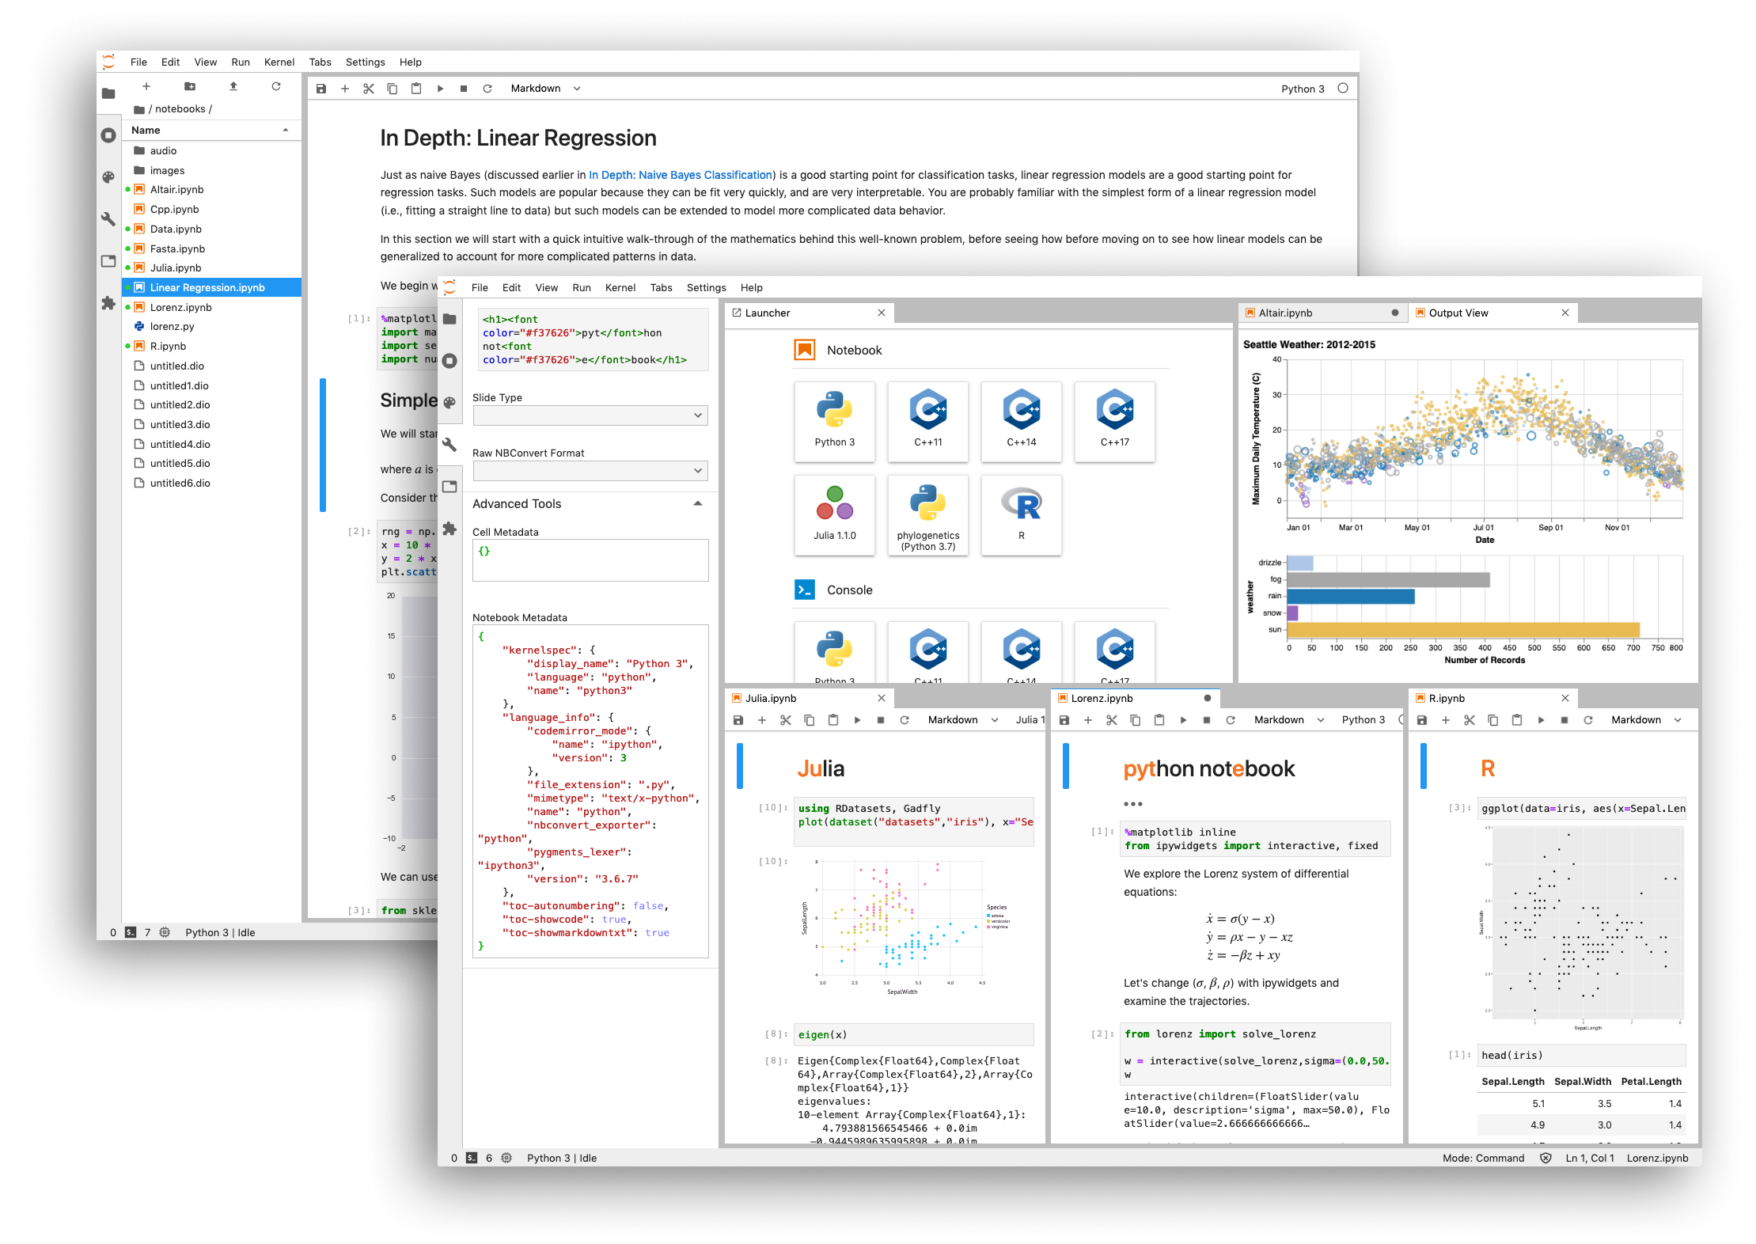
Jupyter notebook

Slide 22
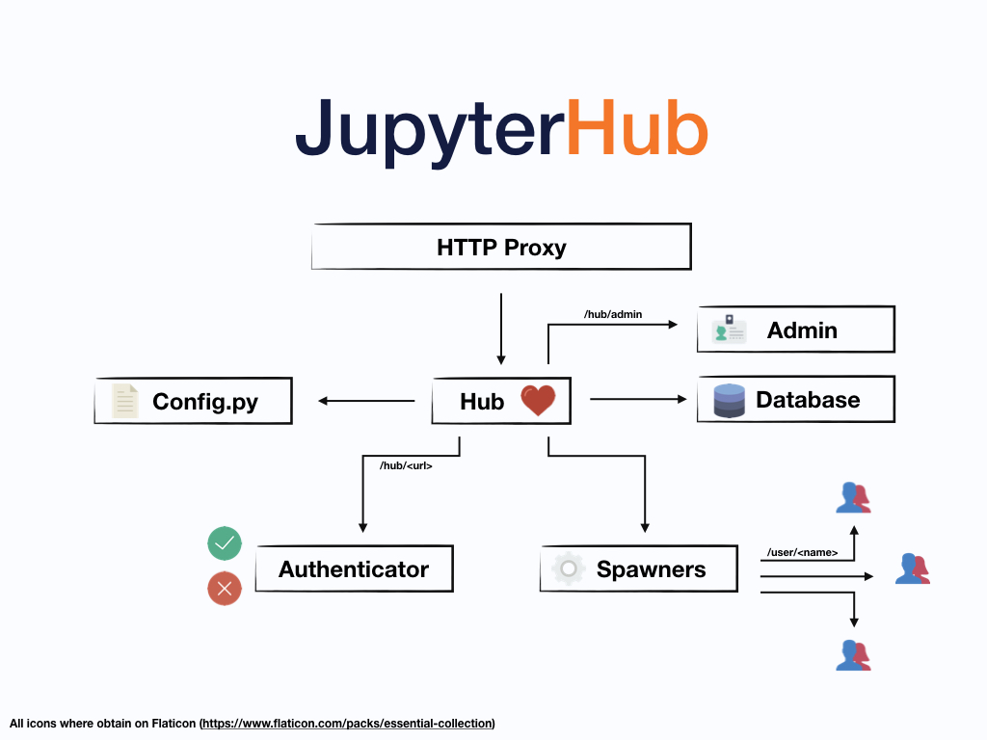
Jupyterhub

Slide 23
How to get help on Lilac and Juno
First, email as much detail as possible (including command, output, account, cluster, and JobIDs) to: hpc-request@cbio.mskcc.org
Other ways to contact us: http://hpc.mskcc.org/contact-us/

Slide 24
                Question & Answer Session

Slide 25
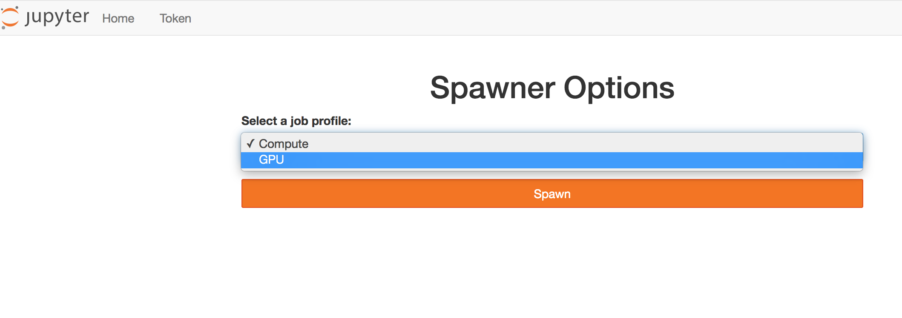
Lilac-Jupyterhub

Slide 26
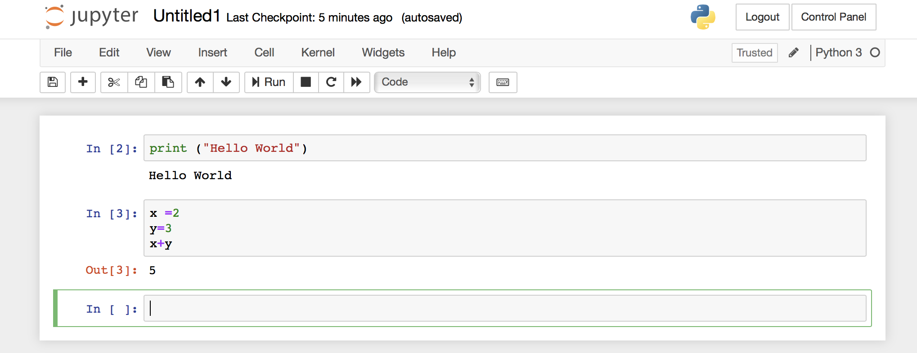
Lilac-Jupyterhub

Slide 27
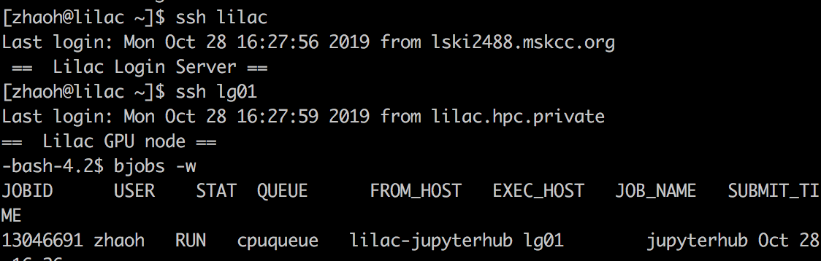
Lilac-Jupyterhub

