Slide 1
HPC User Group
September 21, 2017

Slide 2
Agenda
HPC website and new wiki pages and documentation
LILAC LSF software upgrade overview
LILAC LSF software upgrade plan
LILAC LSF new queues
LUNA upgrade 2017 Q4
Questions

Slide 3

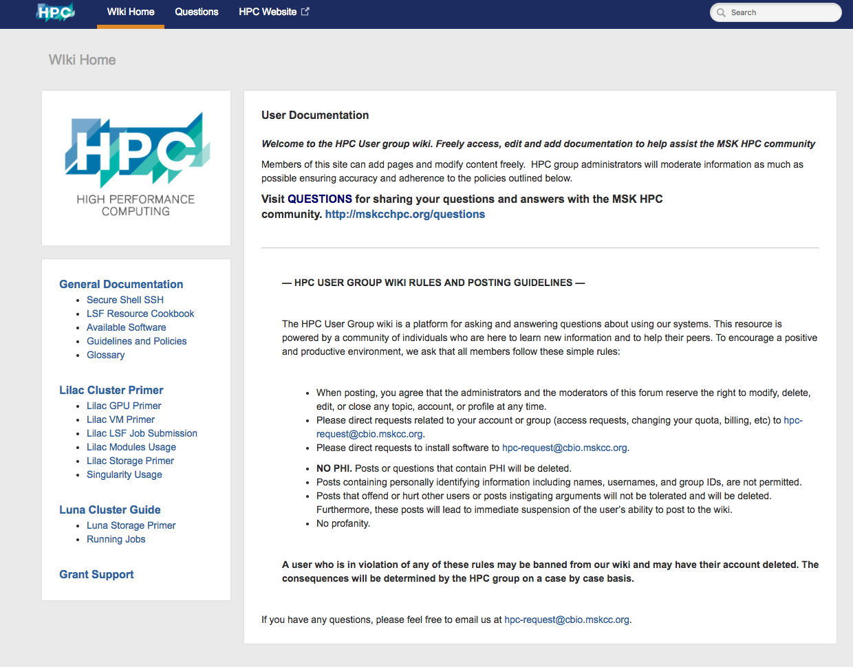
HPC Website and new wiki page and documentation
Website: http://hpc.mskcc.org (internal)
Documentation: http://mskcchpc.org
Notes:
Go to live site. Demonstrate the new ways to get around. Go to documentation, show questions. Demonstrate being a users and contributing. Internal vs. external access show GRAFANA

Slide 4
LILAC LSF software upgrade overview
LSF 10.1 SP3:
- implement the new GPU resource
- allow jobs to request GPU mode and MPS, and specify if GPUs (shared mode only) can be used by other jobs in bsub
- allow jobs to request GPUs in shared mode for job arrays
- enable us to remove LSF customizations on LILAC
New GPU bsub flags:
bsub -gpu "[num=num_gpus] [:mode=shared | exclusive_process] [:mps=yes | no] [:j_exclusive=yes | no]”
Default GPU settings:
"num=1:mode=exclusive_process:mps=no:j_exclusive=yes"

Slide 5
LILAC LSF software upgrade plan
LILAC users will not be able submit any jobs for 4 hours during upgrade
The general queue will be closed
All GPU jobs must be stopped
CPU jobs can continue to run
After upgrade:
New queues will be opened
GPU jobs should use the new syntax and submit jobs to gpuqueue
IBM doc: https://www.ibm.com/support/knowledgecenter/SSWRJV_10.1.0/lsf_command_ref/bsub.gpu.1.html#reference_kqd_3kh_xz

Slide 6
LILAC LSF new queues
Current LILAC queues | New LILAC queues
general (default queue) | cpuqueue (default queue )
gpushared | gpuqueue
wholenode | wholenode
New! cpuqueue has only 68 slots & 486GB of RAM per (ls##) host
New! GPU jobs should specify queue in bsub:
bsub -q gpuqueue -gpu …
New! to check available GPUs on LILAC:
lsload -o "HOST_NAME ngpus_physical"
All queues have default resource parameters for jobs:
1 cpu thread (-n1); 2GB of memory (rusage[mem=2]); 1 hour (-W 1:00) runtime

Slide 7
LUNA upgrade 2017 Q4
Upgrade LSF 9.1.3 to LSF 10.1 SP3
Start OS upgrade from CentOS 6 to CentOS 7
Build and test new software stack on CentOS 7
Add new GPFS storage to CentOS 7 hosts

Slide 8
Questions

